Slide 1
API and Python training
Session 3
Notes:
We’ll be using Python version 3, specifically from version 3.6.
The latest version is 3.9, they are backward compatible, so use any version above 3.6
There is Python version 2 which is not compatible with version 3, and still widely used, just bear in mind your Python 3 code won’t work on Python 2.

Slide 2
This session agenda
Why Python
IDE - Integrated Development Environment
Python virtual environments
Variables
Simple data types – integer, float, string, bool
Data types conversion, output, f-strings
Complex data types – dictionaries and lists
Practice

Slide 3
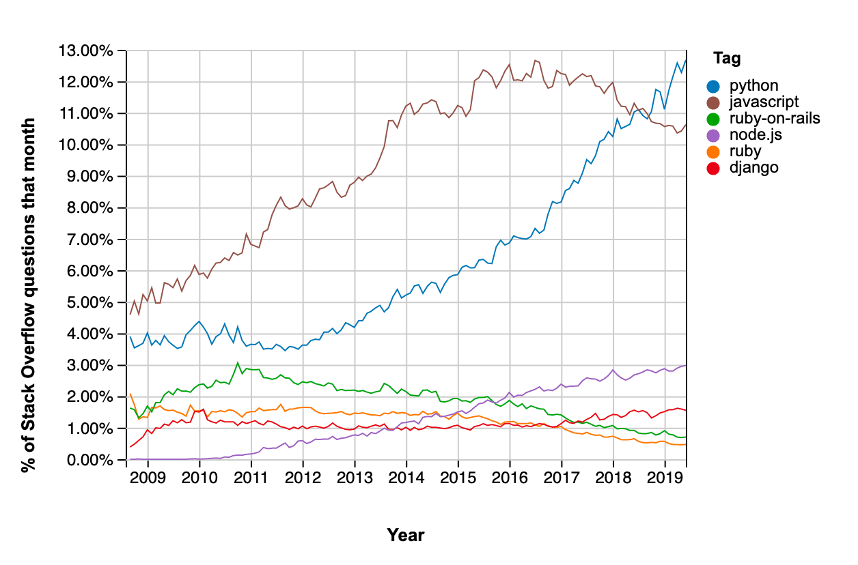
Why Python
We’ll be using Python to consume API because:
Easy to learn
Multi-platform and portable, you can run it the same code on different platforms
A lot of excellent libraries and SDKs allowing you to focus on your app development, instead of low-level comms and data handling
Easy to make requests, parse responses,
manipulate data, implement logic – if …then … else
Broad community to support, easy to find answer
to your question online, for example,
stackoverflow.com
Many network vendors build modules for Python
Popular automation tools and frameworks build
using Python – Ansible, NAPALM, Nornir
Most popular programming language in the world
https://www.monterail.com/blog/what-is-python-and-why-is-it-so-popular
Notes:
I’ve included a link for you to read about Python history and The Zen of Python, definitely worth reading.

Slide 4
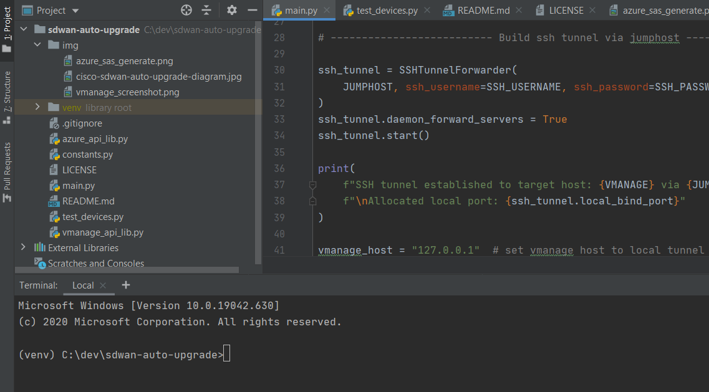
IDE
Multiple vendors – do your research and choose your favorite
Syntax highlighting
Auto-completion
Automatic dependency install
Error checking, suggestions
Project and folders navigation
Plugins, integration with third-party tools, such as Git, Docker, AWS, etc.
Easier debugging
Terminal window
Notes:
https://www.jetbrains.com/pycharm/download/ - use free community edition]
VS code - https://code.visualstudio.com/docs/python/python-tutorial
You can google VS code vs pycharm to see different opinions ☺

Slide 5
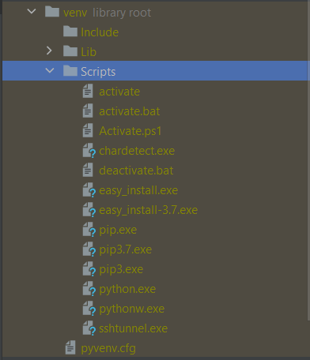
Python Virtual Environments (venv)
Isolate different projects from each other
Avoid dependency conflicts
When you create venv, a separate folder is created, default system Python version is copied to scripts or bin directory
All libraries are installed to Lib directory
To switch between venv, use activate command, the CLI prompt will change to (venv)
Create and switch to venv:
Windows
python3 -m venv <env.name>
cd <env.name>
Scripts\activate.bat
Linux
mkdir <env.name>
cd <env.name>
python3 -m venv .
source bin/activate

Slide 6
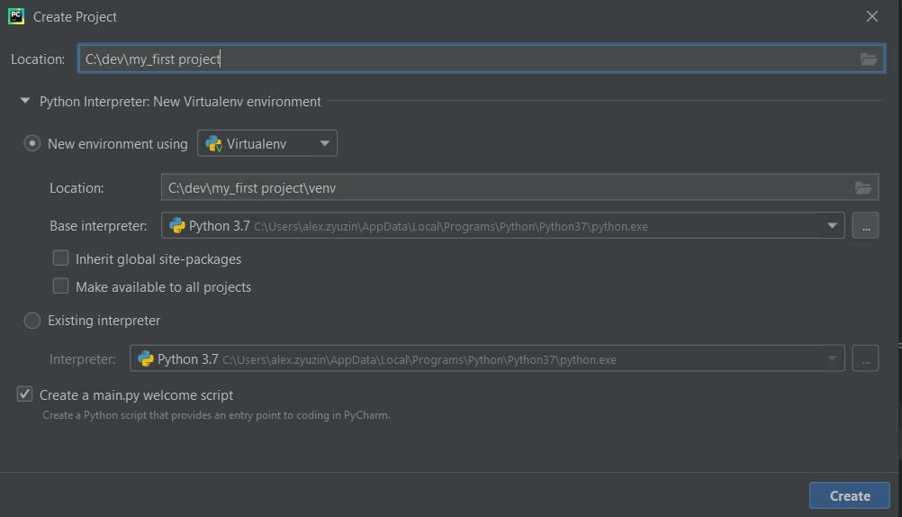
Python Virtual Environments (venv)
When you create a project, IDE creates venv automatically for you
---------------------->

Slide 7
Python variables
Variables are not declared in advance
You don’t have to define variable type (but you can)
You simply introduce them in the code, like this:
a = 5
b = 10
c = a + b
d = c
Important about = sign, this is assignment, not equal
Case sensitive
Give variables meaningful names, in Python names usually substitute spaces with underscores e.g. my_cool_variable
https://realpython.com/python-pep8/
All variables can be changed, there is no concept as constants, variable you can’t change, so you often can see CAPITAL_LETTER_VARIABLES, which means you be careful and shouldn’t change them, but you can.
There are some data types called immutable which you can’t change, such as tuples
Notes:
Sometimes you’ll see variable names in capital letters, it usually means these variables are pre-defined in the code already, and you need to be careful not to overwrite it.
In some languages you can declare variable as read-only, in Python there is no such concept, and you can overwrite any variable.
The only exception is some data types, like tuples, they are called immutable
Very important point about the equal sign.
If you see a variable then equal sign, and then value or another variable it means assignment, so you assign value 5 to variable a in our example.
To really compare two variables you use different symbols, we’ll cover it later.

Slide 8
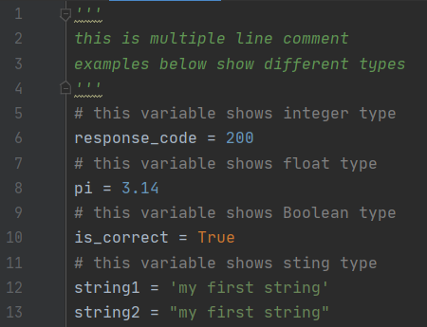
Data types
ALL variables have a type
Types determine how variables are stored in memory and what operations are allowed
It’s important to know what type it is
Simple data types – integer, float, string, boolean
int - Integers, like in previous example, can have minus sign
float - 3.14159
str – string- enclosed in single quotes or double quotes
bool - True or False – note the values are Capitalised
Not a data type, but comments can be single-line starts with #
or multiple lines enclosed in triple quotes or double quotes

Slide 9
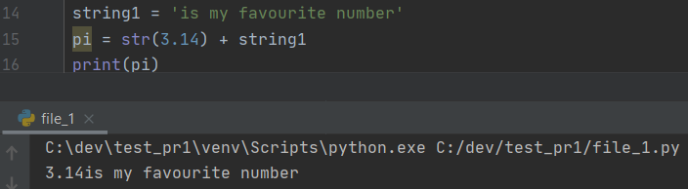
Output. Type conversion
Use print command to output. Easy:
You always print string – note it’s in quotes
Use + which is string concatenation
You can’t make some operations on different data types
In some cases you need to convert data types
Need to convert float to string first
Note there is no space between two strings, add leading
space manually to make the output pretty

Slide 10
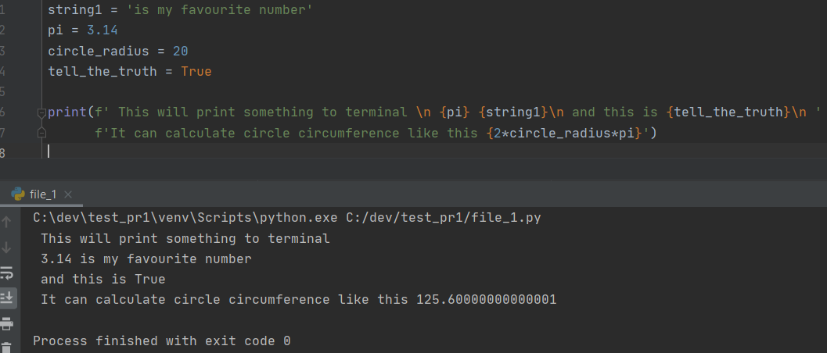
f-strings
Powerful feature available from Python 3.6 are format-strings
f and then quotes or double quotes
Does automatic types conversion
Supports special characters
Supports operations
inside the f-string
Produces just a string
We’ll use it often
https://realpython.com/python-f-strings/

Slide 11
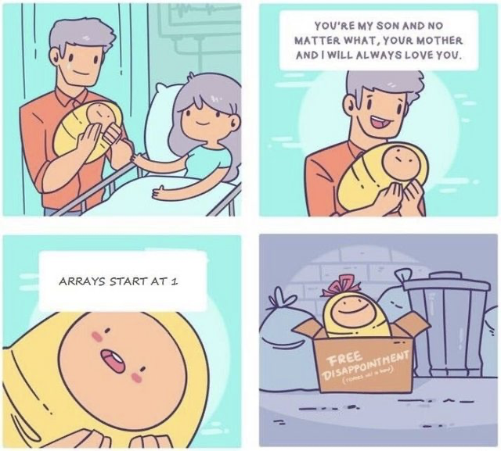
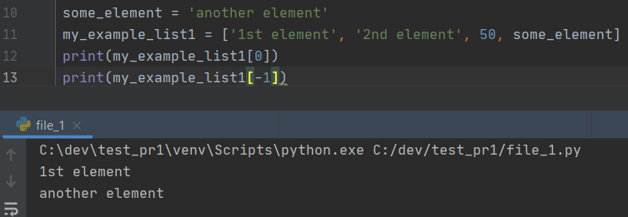
Complex Data Types - List
Multiple data types, we’ll be using lists and dictionaries, check another two types used often - tuples and sets
Lists – also called sequence, sometimes one-dimensional array
Ordered sequence of simple variables
To define variable use square brackets [ ]
Elements can be different types
You can include variables
To access an element use [<element number>]
Fist element is 0, to count from the end, use negative
source: imgur
Notes:
Lists are also called sequences or one-dimensional arrays.
It consists of elements, and you can access them using their number also called as index.
The elements can be different types, so you can have a mix of strings of integers, for example, but it’s not very common and in most cases you’ll see list of strings, or list of integers, not a mix of them.

Slide 12
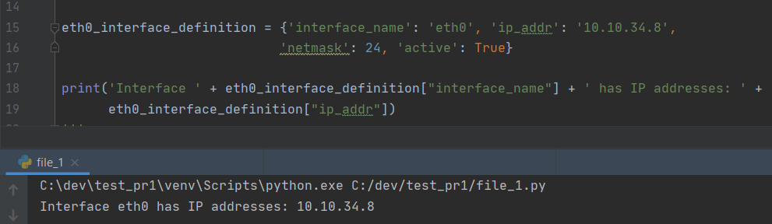
Complex Data Types - Dictionary
Unordered key-value pairs, also called hash-tables
To access value you use a key
Keys must be unique
To define the dictionary use {}
To access a value use the key, which is enclosed in [ ] - note it is similar to lists where you also use [ ] to access an element
Notes:
Dictionary is a key-value pair, so you store a value and assign a key to it.
To access the value, you use this key.
This structure is also called hashtable.
To define a dictionary, use curly brackets.
Inside the curly brackets key-value pairs are comma separated, the elements are key-column-value
To access the value, we use square brackets, similar to lists, but in lists we use an integer index to get the element, and in dictionary we use the key name.

Slide 13

Next is the most important slide

Slide 14
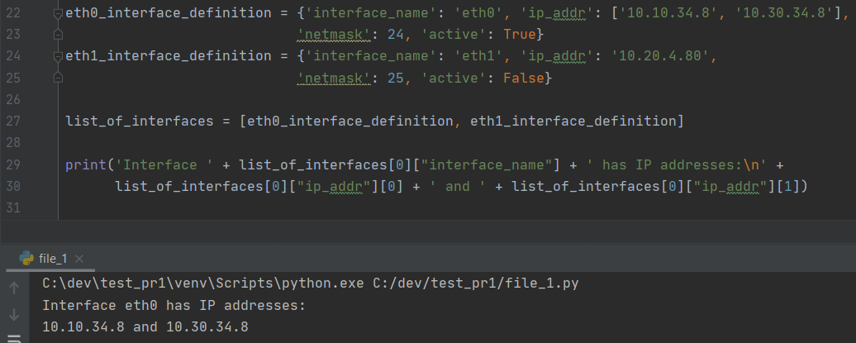
Nested complex data types
Very often you’ll see combination of complex data types, this is what will be returned as API response
For example, dictionaries which use lists as values, lists of lists, lists with dictionaries as elements, etc
It’s important to learn how to access them
list_of_interfaces[0]["ip_addr"][1]
1. Using list_of_interfaces[0] you get
variable eth0_interface_definition
2. eth0_interface_definition["ip_addr"]
retrieves the list
['10.10.34.8', '10.30.34.8’]
3. [1] gives you the second element in the
List which is the string

Slide 15
Demo

Slide 16
Summary and next steps
Summary
Python – IDE, venv, variables, simple and complex data types
Homework
Try simple data types
Try f-strings
Build your own lists and dictionaries
Build list of dictionaries, list of lists, complex dictionaries, the more complex the better
Try to access data, print it using f-strings
Next time
Control structures – if, for, when
Importing third-party libraries
Requests and JSON libraries
Make first API call with Python

